Slide 1
Data Privacy

Slide 2

Our world is increasingly data driven
Source (http://www.agencypja.com/site/assets/files/1826/marketingdata-1.jpg)
2

Slide 3
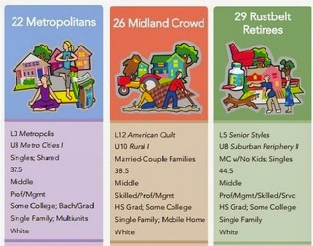
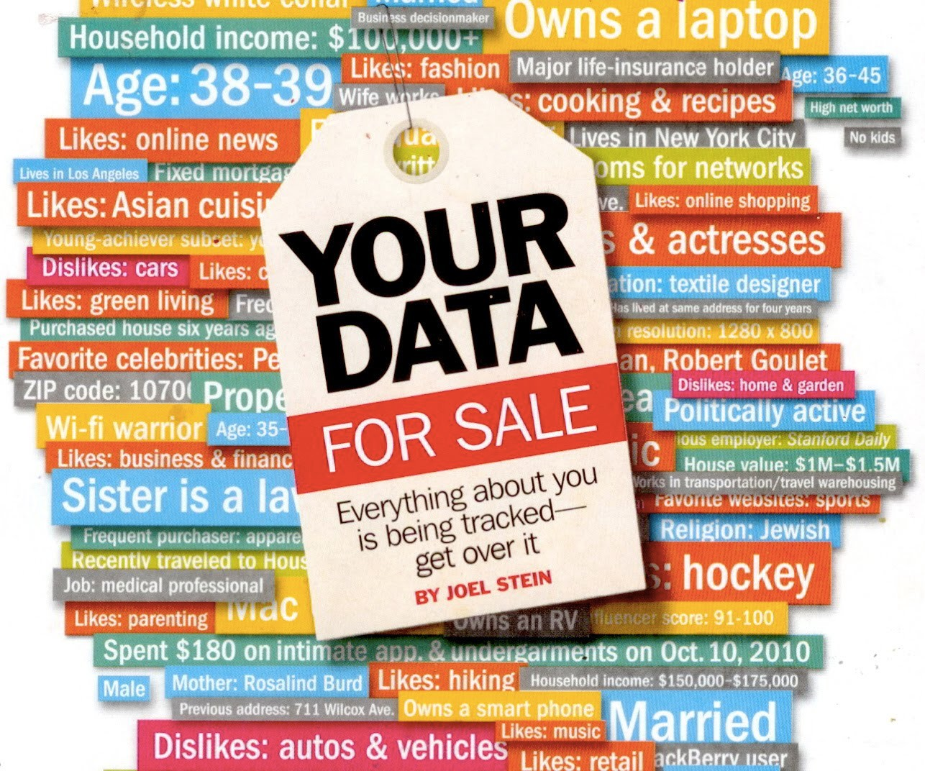

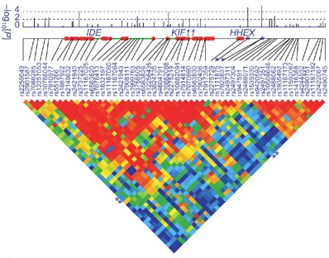


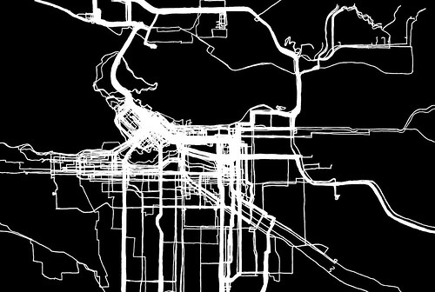
Learning Personal Data is invaluable
Advertising
Source (esri.com)
Genome Wide Association Studies
Human Mobility analysis
Tutorial: Differential Privacy in the Wild
4

Slide 4









Personal data is … well … personal!
Redlining
Age Income Address
Likes/Dislikes
Sexual Orientation
Medical History
Discrimination
Source (time.com)
Physical/Financial Harm

Slide 5


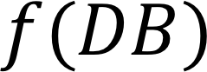
Statistical Database Privacy
Function provided by the analyst
Server
Output can disclose sensitive information about individuals
DB
Person 1
r₁
Person 2
r₂
Person 3
r₃
Person N
r_{N}
Module 1

Slide 6






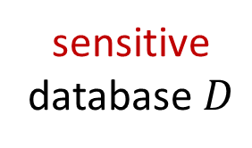
Data Release
company
institute
sensitive
database $D$
public
adversary

Slide 7


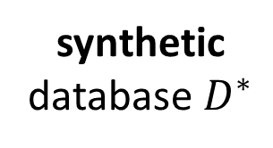
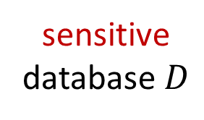
Private Data Release
similar properties
company
accurate inference
sensitive
database $D$
synthetic
database $D^{∗}$
How can we design such a
private data release algorithm?
adversary

Slide 8

Privacy Preserving Deep Learning
Privacy issue in deep neural network

Slide 9
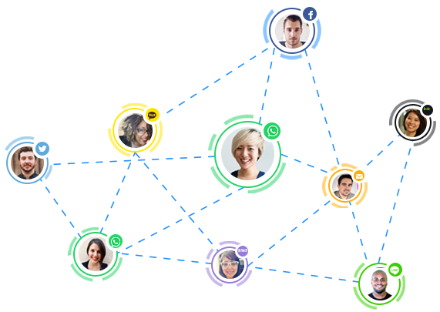
Network (Graph) Privacy
For social network data, privacy can be :
Identity disclosure:
the identity of an individual who is associated with a node is revealed
Link disclosure:
the sensitive relationship between individuals is disclosed
Content disclosure
the sensitive data associated with each node or edge
e.g., age, political beliefs, etc, associated with a node,
properties such as the degree of a node, and general graph properties, etc

Slide 10
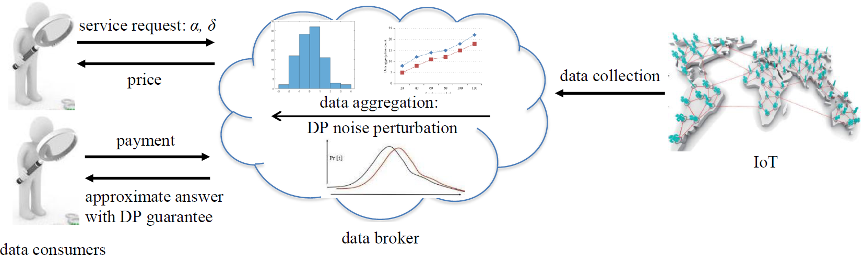
Trading private aggregation over big IoT data

Slide 11
Motivation: Data Privacy Protection
Organizations typically need to publish data e.g., census data or election data
Data publishing gives useful information to researchers and analyzers
At the same time, it extends a privacy risk to individuals whose data is being published
We need strong privacy notions that enable us to confine the disclosure risk while simultaneously maximize the benefits

Slide 12
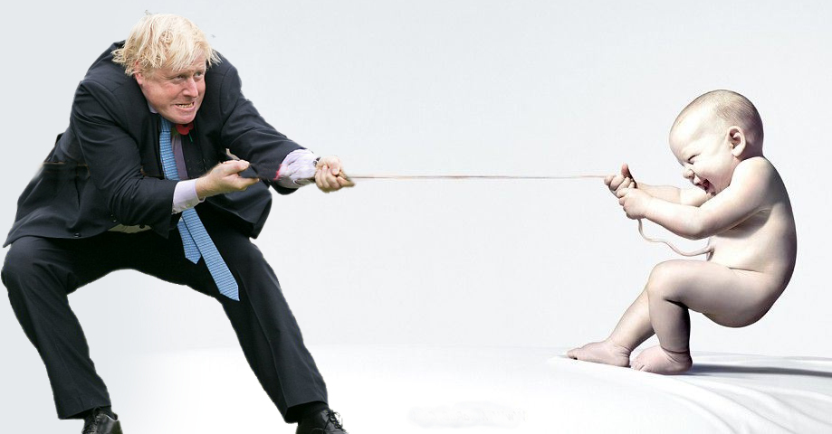
Multiple Aspects Must be Balanced
Privacy-Utility tradeoff
Preserving the privacy of individuals whose data is included
Usefulness (utility) of the published data
https://www.reddit.com/r/photoshopbattles/comments/3qexjl/psbattle_boris_johnson_tug_of_war/

Slide 13
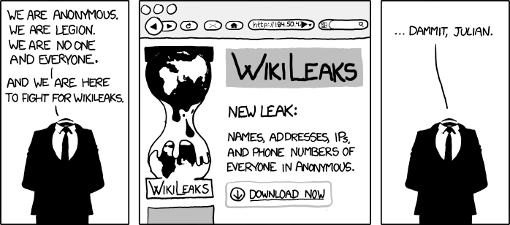
That’s fine … I am anonymous!
Source (http://xkcd.org/834/)

Slide 14
Data Anonymization

Slide 15
Data Anonymization
Data anonymization is a type of information sanitization whose intent is privacy protection.
It is the process of either encrypting or removing personally identifiable information from data sets, so that the people whom the data describe remain anonymous.

Slide 16
GIC Incidence [Sweeny 2002]
Group Insurance Commissions (GIC, Massachusetts)
Collected patient data for ~135,000 state employees.
Gave to researchers and sold to industry.
Patient 1
Patient 2
……
Patient n
……
Name
Bob
Carl
Daisy
Emily
Flora
Gabriel
Age | Sex | Zip code | Disease
69 | M | 47906 | Cancer
65 | M | 47907 | Cancer
52 | F | 47902 | Flu
43 | F | 46204 | Gastritis
42 | F | 46208 | Hepatitis
47 | F | 46203 | Bronchitis
GIC, MA
DB

Slide 17
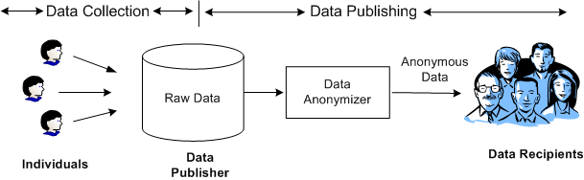
Overview
Anonymization
algorithm
17
Data utility
Privacy model

Slide 18
Naïve Anonymization is susceptible to Linkage Attacks
Zip | Age | Nationality | Disease
13053 | 28 | Russian | Heart
13068 | 29 | American | Heart
13068 | 21 | Japanese | Viral
13053 | 23 | American | Viral
14853 | 50 | Indian | Cancer
14853 | 55 | Russian | Heart
14850 | 47 | American | Viral
14850 | 59 | American | Viral
13053 | 31 | American | Cancer
13053 | 37 | Indian | Cancer
13068 | 36 | Japanese | Cancer
13068 | 32 | American | Cancer
Quasi-Identifier

Slide 19
k-Anonymity
k-Anonymity
Each record is indistinguishable from k-1 other records
These k records form an equivalence class
To achieve k-Anonymity, uses
Generalization: Replace with less-specific values
Suppression: Remove outliers
476**
2*
*
47677
47602
47678
29
22
27
Male
Female
Zipcode
Age
Gender

Slide 20
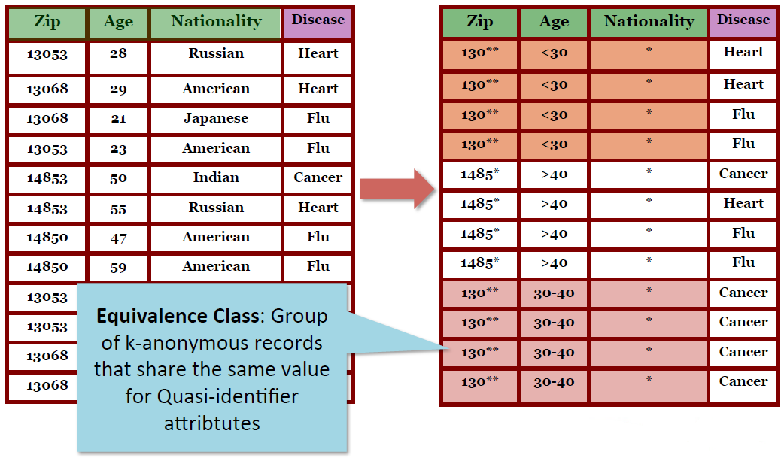
Example 1: Generalization (Coarsening)

Slide 21
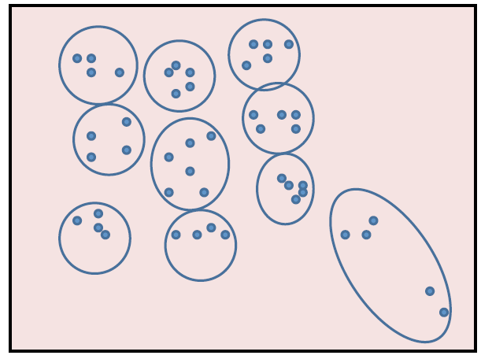
Example 1: Clustering

Slide 22

Example 2: Micro-aggregation
 |  |  | Disease
13053 | 28 | Russian | Heart
13068 | 29 | American | Heart
13068 | 21 | Japanese | Flu
13053 | 23 | American | Flu
14853 | 50 | Indian | Cancer
14853 | 55 | Russian | Heart
14850 | 47 | American | Flu
14850 | 59 | American | Flu
13053 | 31 | American | Cancer
13053 | 37 | Indian | Cancer
13068 | 36 | Japanese | Cancer
13068 | 32 | American | Cancer
Zip Age Nationality
Zip | Age | Nationality | Disease
4 tuples |  |  | 2 Heart
Zip code = 130** 23 < Age < 29 |  |  | and 2 Flu
Average(age) = 25
4 tuples |  |  | 1 Cancer,
Zip = 1485* |  |  | 1 Heart
47 < Age < 59 |  |  | and
Average(age) = 53 |  |  | 2 Flu
4 tuples |  |  | All
Zip = 130** 31 < Age < 37 |  |  | Cancer patients
Avergae(age) = 34

Slide 23
Does k-­‐Anonymity guarantee suﬃcient privacy ?

Slide 24
Adack 1: Homogeneity
Zip | Age | Nat. | Disease
130** <30 * Heart
130** <30 * Heart
130** <30 * Flu
130** <30 * Flu
1485* >40 * Cancer 1485* >40 * Heart
1485* >40 * Flu
1485* >40 * Flu
Bob has Cancer
130** | 30-40 | * | Cancer
130** | 30-40 | * | Cancer
130** | 30-40 | * | Cancer
130** | 30-40 | * | Cancer
Name | Zip | Age | Nat.
Bob | 13053 | 35 | ??

Slide 25
Adack 2: Background knowledge
Zip | Age | Nat. | Disease
130** | <30 | * | Heart
130** | <30 | * | Heart
130** | <30 | * | Flu
130** | <30 | * | Flu
Name | Zip | Age | Nat.
Umeko | 13068 | 24 | Japan
1485* >40 * Cancer
1485* >40 * Heart
1485* >40 * Flu
1485* >40 * Flu
130** 30-40 * Cancer
130** 30-40 * Cancer
130** 30-40 * Cancer
130** 30-40 * Cancer

Slide 26

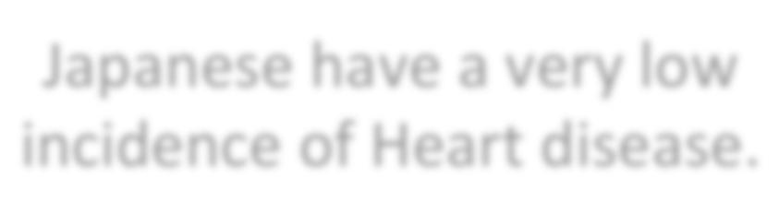
Adack 2: Background knowledge
Zip | Age | Nat. | Disease
130** <30 * Heart
130** <30 * Heart
Name | Zip | Age | Nat.
Umeko | 13068 | 24 | Japan
130** | <30 | * | Flu
130** | <30 | * | Flu
Japanese have a very low incidence of Heart disease.
1485* >40 * Cancer
1485* >40 * Heart
1485* >40 * Flu
1485* >40 * Flu
130** 30-40 * Cancer
130** 30-40 * Cancer
130** 30-40 * Cancer
130** 30-40 * Cancer
Umeko has Flu

Slide 27
Example of k-Anonymity
The Microdata
The Generalized Table
QID |  |  | SA
Zipcode | Age | Gen | Disease
47677 | 29 | F | Ovarian Cancer
47602 | 22 | F | Ovarian Cancer
47678 | 27 | M | Prostate Cancer
47905 | 43 | M | Flu
47909 | 52 | F | Heart Disease
47906 | 47 | M | Heart Disease
QID |  |  | SA
Zipcode | Age | Gen | Disease
476** 476** 476** | 2* 2* 2* | * * * | Ovarian Cancer Ovarian Cancer Prostate Cancer
4790* 4790* 4790* | [43,52] [43,52] [43,52] | * * * | Flu Heart Disease Heart Disease
3-Anonymous table
The adversary knows Alice’s QID values (47677, 29, F)
The adversary does not know which one of the first 3 records corresponds to Alice’s record.

Slide 28
Attacks on k-Anonymity
k-anonymity does not provide privacy if:
Sensitive values lack diversity
The attacker has background knowledge
Homogeneity Attack
A 3-anonymous patient table
Bob
Zipcode | Age
47678 | 27
Zipcode | Age | Disease
476** 476** 476** | 2* 2* 2* | Heart Disease Heart Disease Heart Disease
4790* 4790* 4790* | ≥40 ≥40 ≥40 | Flu Heart Disease Cancer
476** 476** 476** | 3* 3* 3* | Heart Disease Cancer Cancer
Background Knowledge Attack
Carl does not have heart disease
Carl
Zipcode | Age
47673 | 36

Slide 29
Limitation of k-Anonymity
Limitation of k-anonymity:
Difficult to pin down due to background knowledge

Slide 30
Differential Privacy

Slide 31
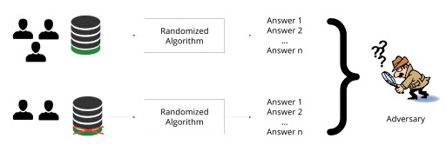
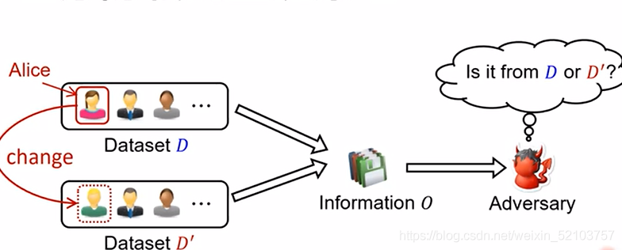

Slide 32





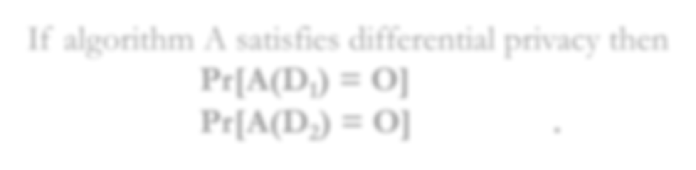



Differential Privacy
For every pair of inputs that differ in one row
For every output …
D₁ D₂ O
If algorithm A satisfies differential privacy then
Pr[A(D₁) = O] _{< exp(ε)}
(ε>0)
Pr[A(D₂) = O]
Intuition: adversary should not be able to use output O to distinguish between any D₁ and D₂
Mo
dule 2 Tutorial: Differential Privacy in the Wild
64

Slide 33
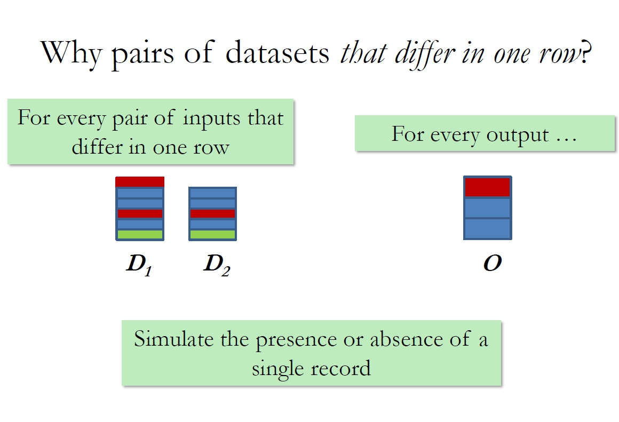

Slide 34
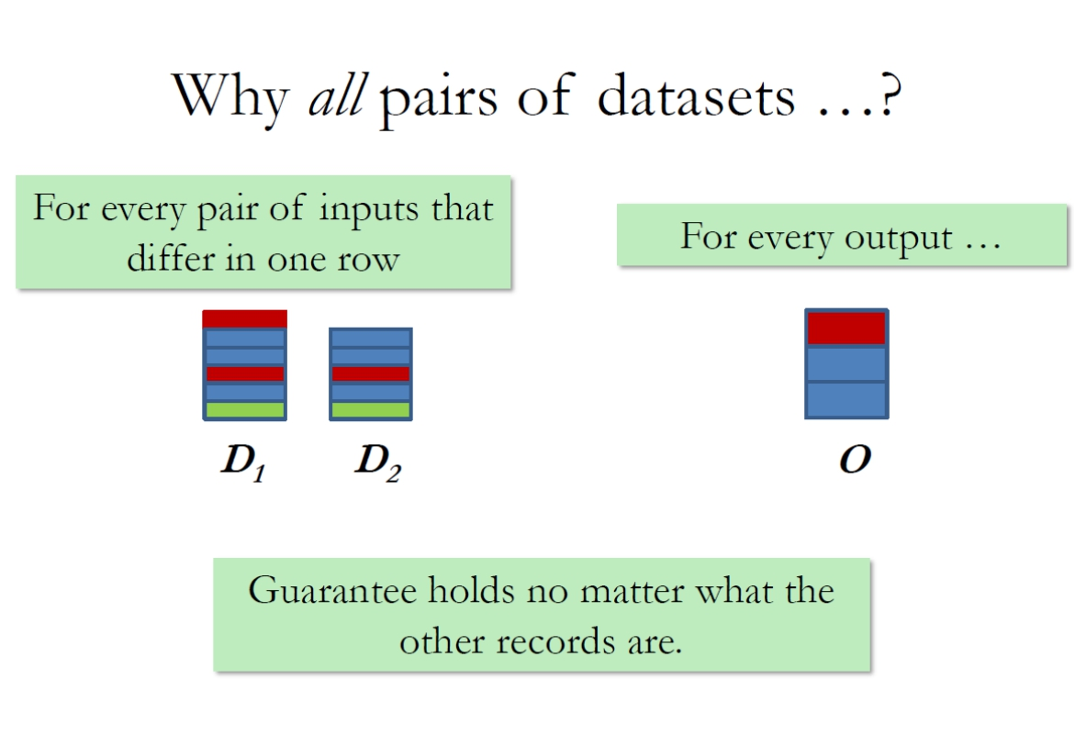

Slide 35








Why all outputs?
P [ A(D₁) = O₁ ]
A(D₁) = O₁
D₁
.
.
.
D₂
P [ A(D₂) = O_{k} ]
Set of all outputs
Module 2
Tutoria
l: Differential Privacy in th
e Wild
67

Slide 36
Should not be able to distinguish whether input was D₁ or D₂ no matter what the output
Worst discrepancy in probabilities
D₁
.
.
.
D₂
Module 2

Slide 37





Privacy Parameter ε
For every pair of inputs that differ in one row
For every output …
D₁ D₂ O
Pr[A(D₁) = O] ≤ e^{ε} Pr[A(D₂) = O]
Controls the degree to which D₁ and D₂ can be distinguished.
Smaller ε gives more privacy (and worse utility)
Module 2

Slide 38
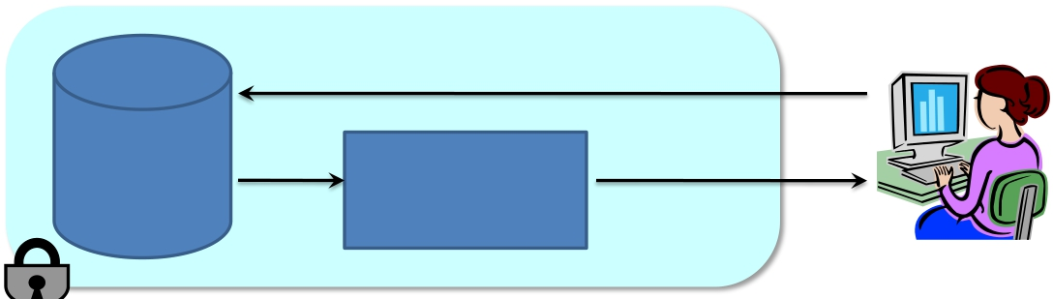
Output Randomization
Query
Database Add noise to
true answer
• Add noise to answers such that:
Researcher
– Each answer does not leak too much information
about the database.
– Noisy answers are close to the original answers.
Module 2 Tutorial: Differential Privacy in the Wild 23

Slide 39
Randomized Response (a.k.a. local randomization)
D O
Disease (Y/ N)
Y
Y
N
Y
N
N
Disease (Y/ N)
Y
N
N
N
Y
N
With probability p, Report true value
With probability 1-­‐p, Report ﬂipped value

Slide 40
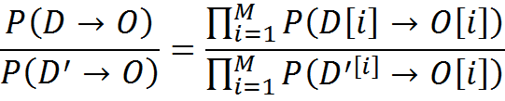
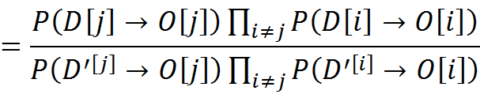


Diﬀerential Privacy Analysis
Consider 2 databases D, D’ (of size M) that diﬀer in the j^{th} value
– D[j] ≠ D’[j]. But, D[i] = D’[i], for all i ≠ j
Consider some output O

Slide 41
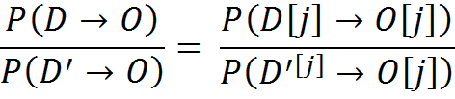

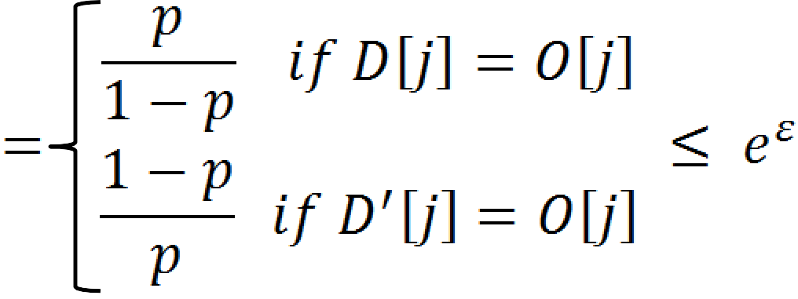
Diﬀerential Privacy Analysis
Consider 2 databases D, D’ (of size M) that diﬀer in the j^{th} value
– D[j] ≠ D’[j]. But, D[i] = D’[i], for all i ≠ j
Consider some output O

Slide 42
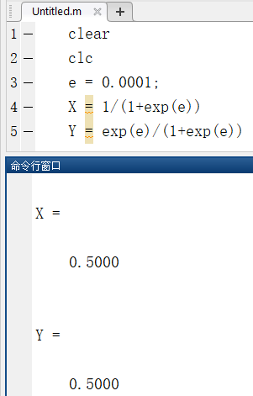
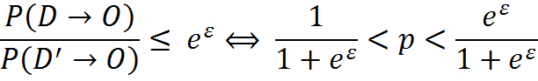
Diﬀerential Privacy Analysis
Consider 2 databases D, D’ (of size M) that diﬀer in the j^{th} value
– D[j] ≠ D’[j]. But, D[i] = D’[i], for all i ≠ j
Consider some output O

Slide 43




Output Randomization
Query
Database
Add noise to true answer
Researcher
Add noise to answers such that:
Each answer does not leak too much information about the database.
Noisy answers are close to the original answers.
Module 2

Slide 44
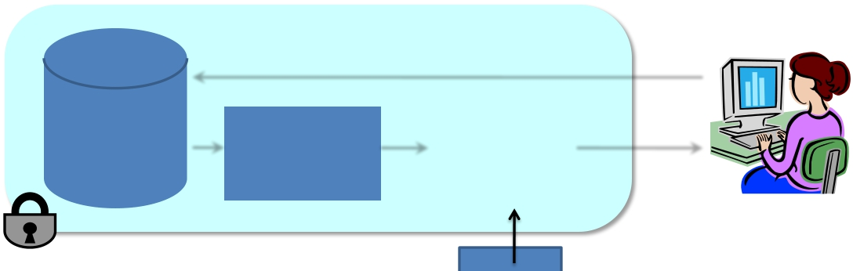

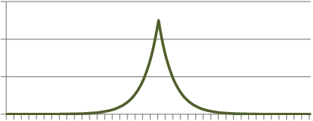
Laplace Mechanism
Query q
 |  | True answer q(D)
 |  |  |  | q(D) + η
Database
Researcher
η
Laplace Distribution – Lap(S/ε)
0.6 0.4 0.2
0
Tutorial: Differential Privacy in the Wild
-10 -8 -6 -4 -2 0 2 4 6 8 10
Module 2
24

Slide 45
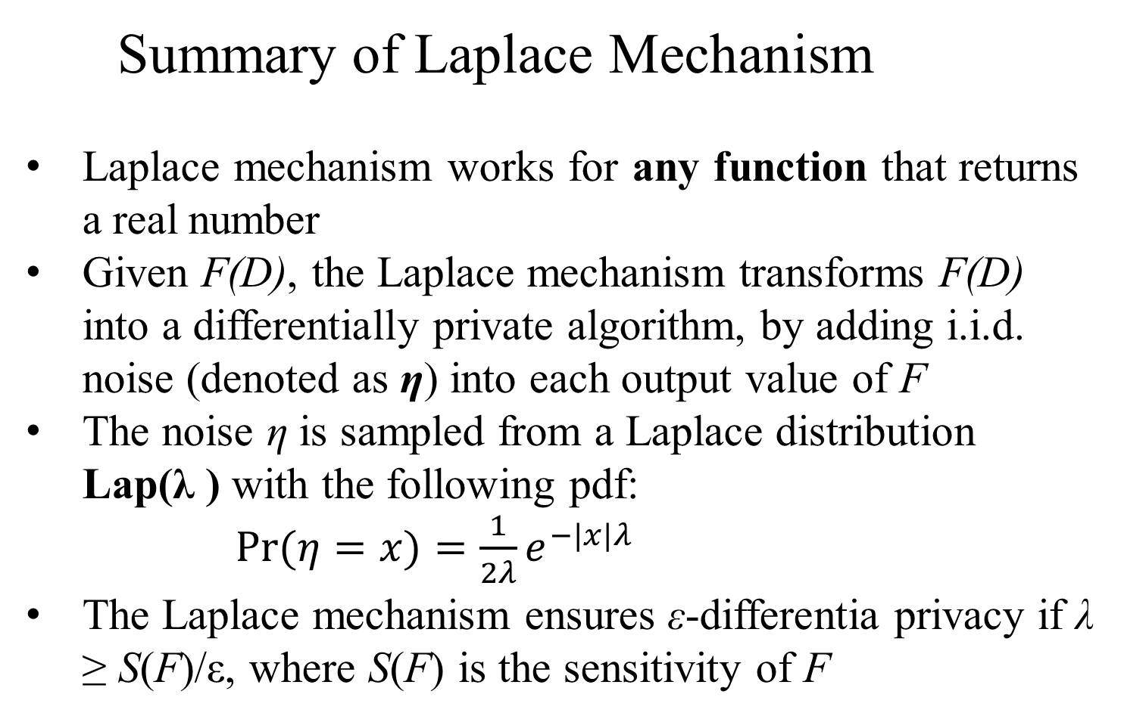
Summary of Laplace Mechanism
Laplace mechanism works for any function that returns a real number
Given F(D), the Laplace mechanism transforms F(D) into a differentially private algorithm, by adding i.i.d. noise (denoted as η) into each output value of F
The noise η is sampled from a Laplace distribution Lap(λ ) with the following pdf:
$Pr⁡(η=x)=\frac{1}{2λ}e^{−|x|λ}$
The Laplace mechanism ensures ε-differentia privacy if λ ≥ S(F)/ε, where S(F) is the sensitivity of F
Notes:
independent identically distributed

Slide 46
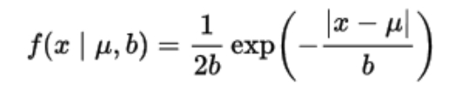
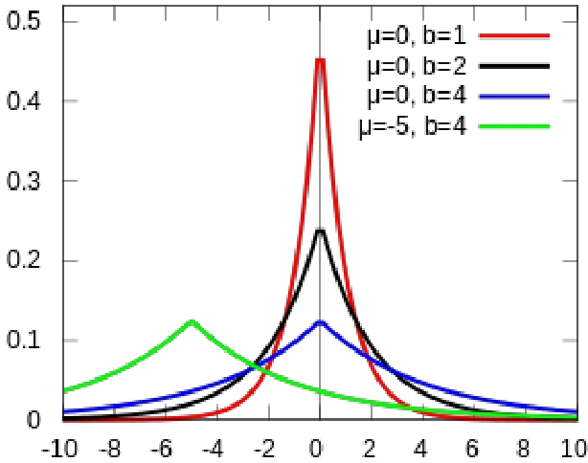
Laplace Distribution
• PDF:
• Denoted as Lap(b) when u=0
• Mean u
• Variance: 2b²
Notes:
PDF: Probability Distribution Function

Slide 47
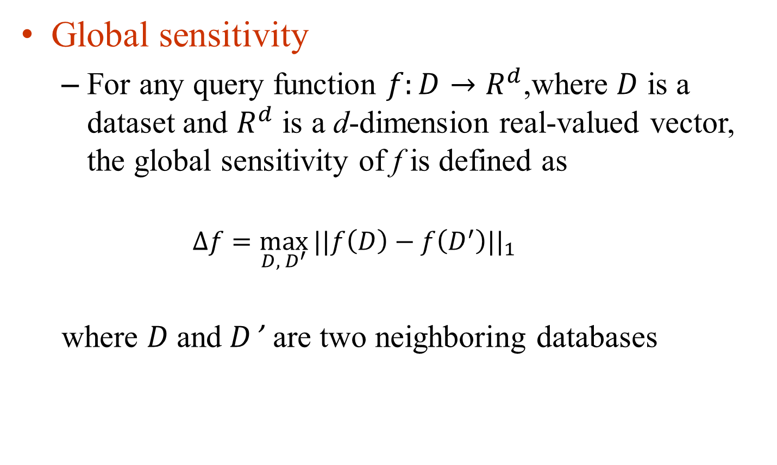
How much noise for privacy?
Global sensitivity
For any query function $f:D→R^{d}$,where $D$ is a dataset and $R^{d}$ is a d-dimension real-valued vector, the global sensitivity of f is defined as
$$∆f=\max_{D, { D}^{′}}{{||f\left(D\right)−f\left(D^{′}\right)||}_{1}}$$
where $D$and $D$’ are two neighboring databases

Slide 48
Example: SUM query
• Suppose all values x are in [a,b]
• Sensitivity = b
Module 2 Tutorial: Differential Privacy in the Wild 28

Slide 49
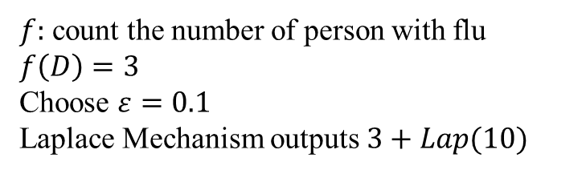
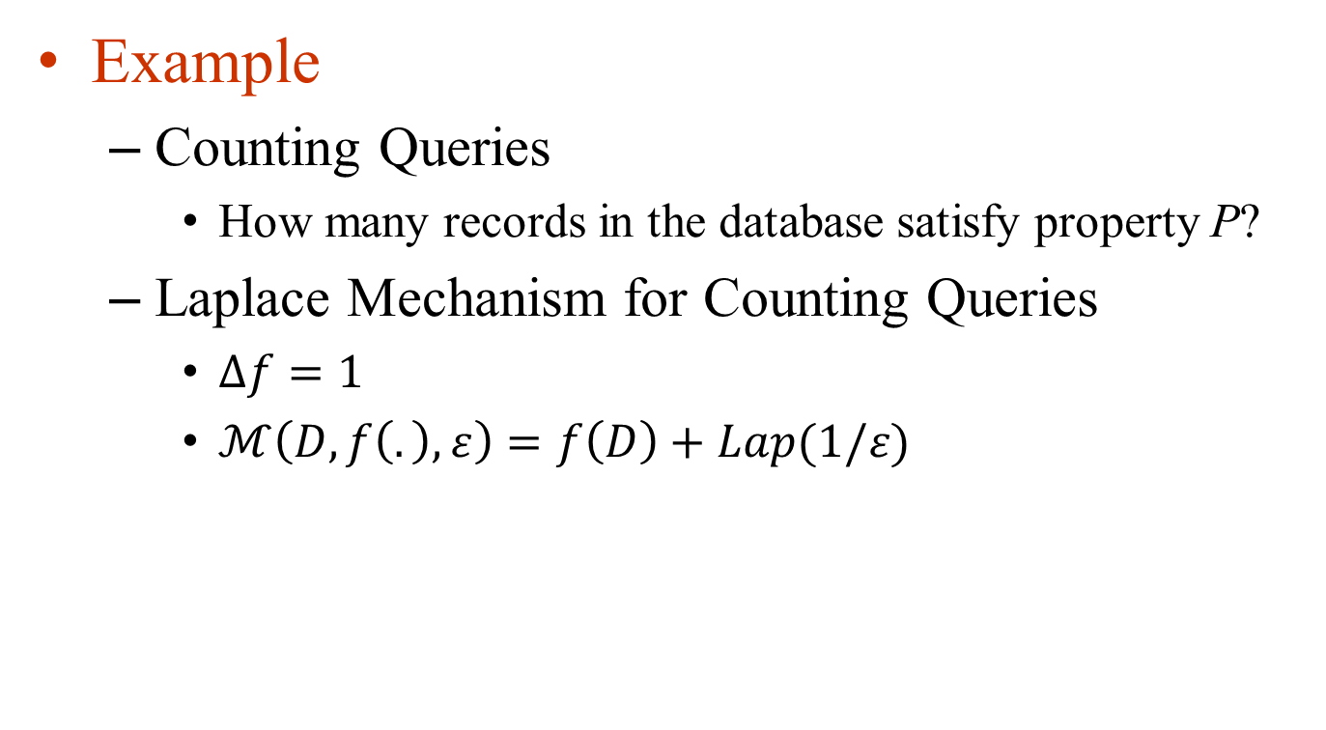
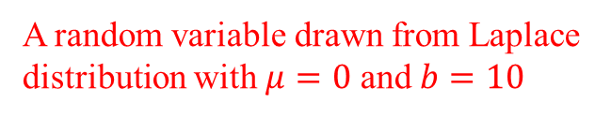
Laplace Mechanism
Example
Counting Queries
How many records in the database satisfy property P?
Laplace Mechanism for Counting Queries
$∆f=1$
$ℳ\left(D,f\left(.\right),ε\right)=f\left(D\right)+Lap(1/ε)$
Name | Flu
Hunter | 1
Alice | 0
Bob | 1
Eric | 0
Frank | 1
$f:$ count the number of person with flu
$$f\left(D\right)=3$$
Choose $ε=0.1$
Laplace Mechanism outputs $3+Lap(10)$
A random variable drawn from Laplace distribution with $μ=0$ and $b=10$

Slide 50
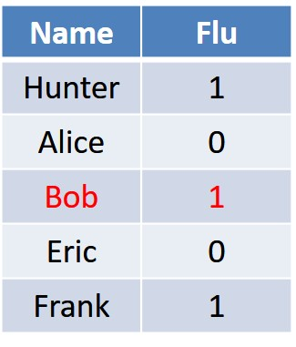
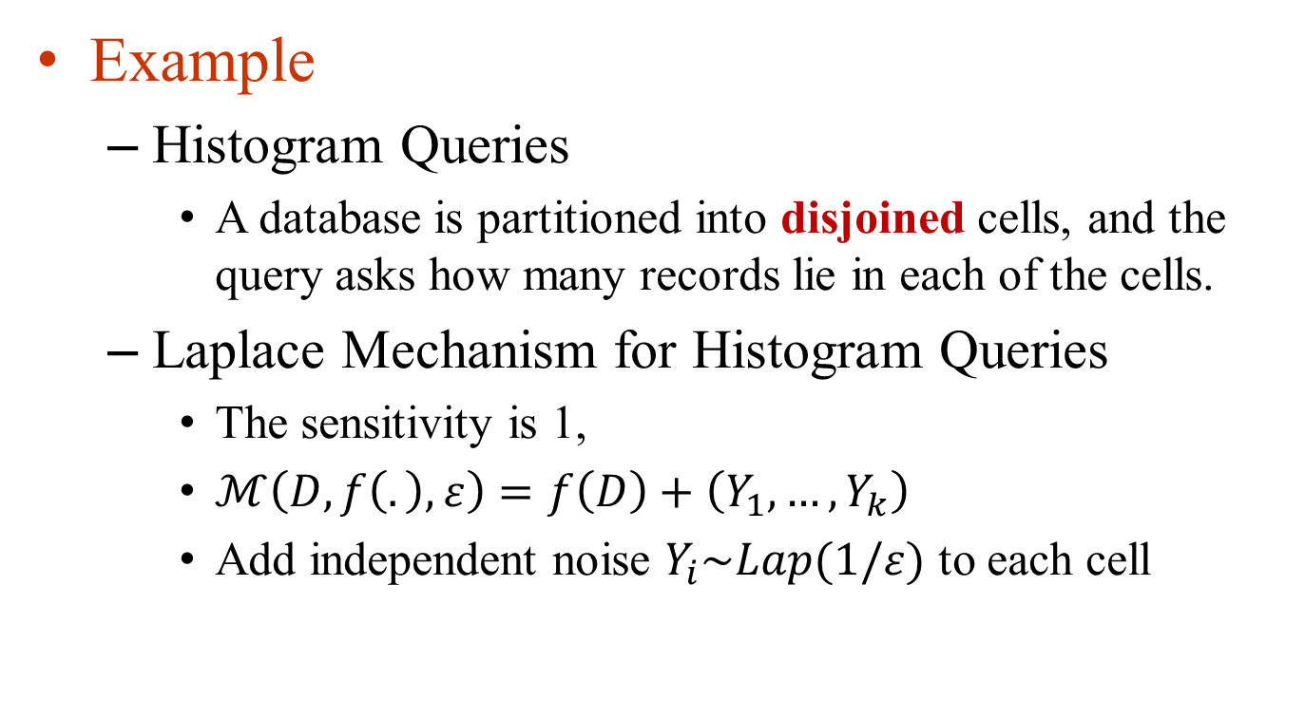
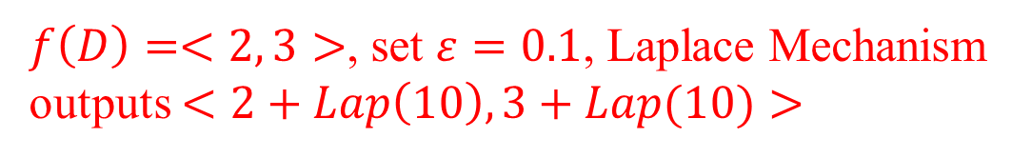
Laplace Mechanism
Example
Histogram Queries
A database is partitioned into disjoined cells, and the query asks how many records lie in each of the cells.
Laplace Mechanism for Histogram Queries
The sensitivity is 1,
$ℳ\left(D,f\left(.\right),ε\right)=f\left(D\right)+\left(Y_{1},…,Y_{k}\right)$
Add independent noise $Y_{i}\sim Lap(1/ε)$ to each cell
$f\left(D\right)=<2, 3>$, set $ε=0.1$, Laplace Mechanism outputs $<2+Lap\left(10\right), 3+Lap(10)>$

Slide 51
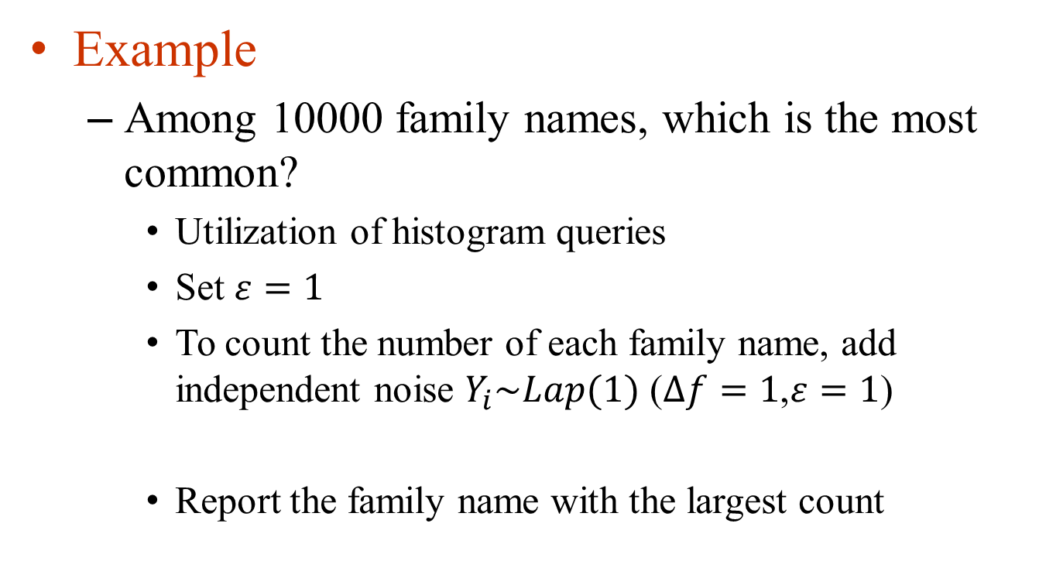
Laplace Mechanism
Example
Among 10000 family names, which is the most common?
Utilization of histogram queries
Set $ε=1$
To count the number of each family name, add independent noise $Y_{i}\sim Lap(1)$ ($∆f=1$,$ε=1$)
Report the family name with the largest count

Slide 52
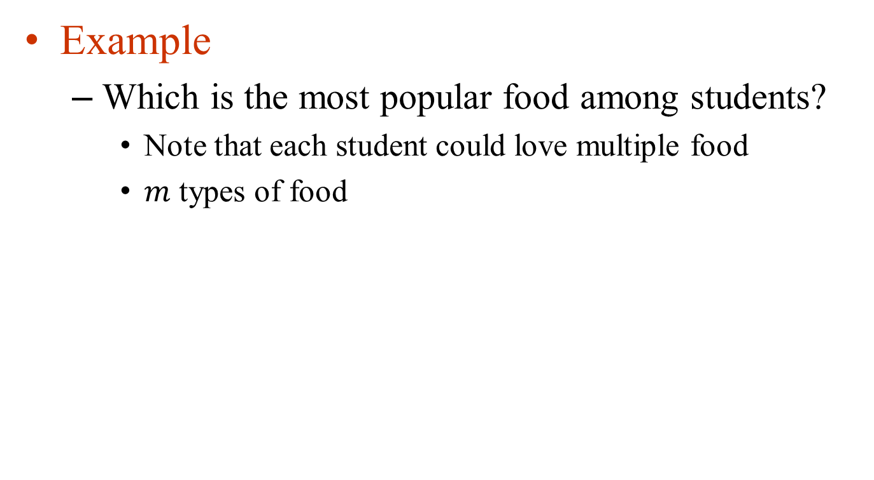
Laplace Mechanism
Example
Which is the most popular food among students?
Note that each student could love multiple food
$m$ types of food
Name | Salad | BBQ | Noodle | Rice | Milk
Frank | 1 | 0 | 1 | 1 | 1
Tom | 0 | 1 | 0 | 1 | 1
Jacky | 0 | 0 | 1 | 0 | 1
Ross | 1 | 1 | 0 | 0 | 0
Monica | 1 | 1 | 0 | 1 | 1

Slide 53
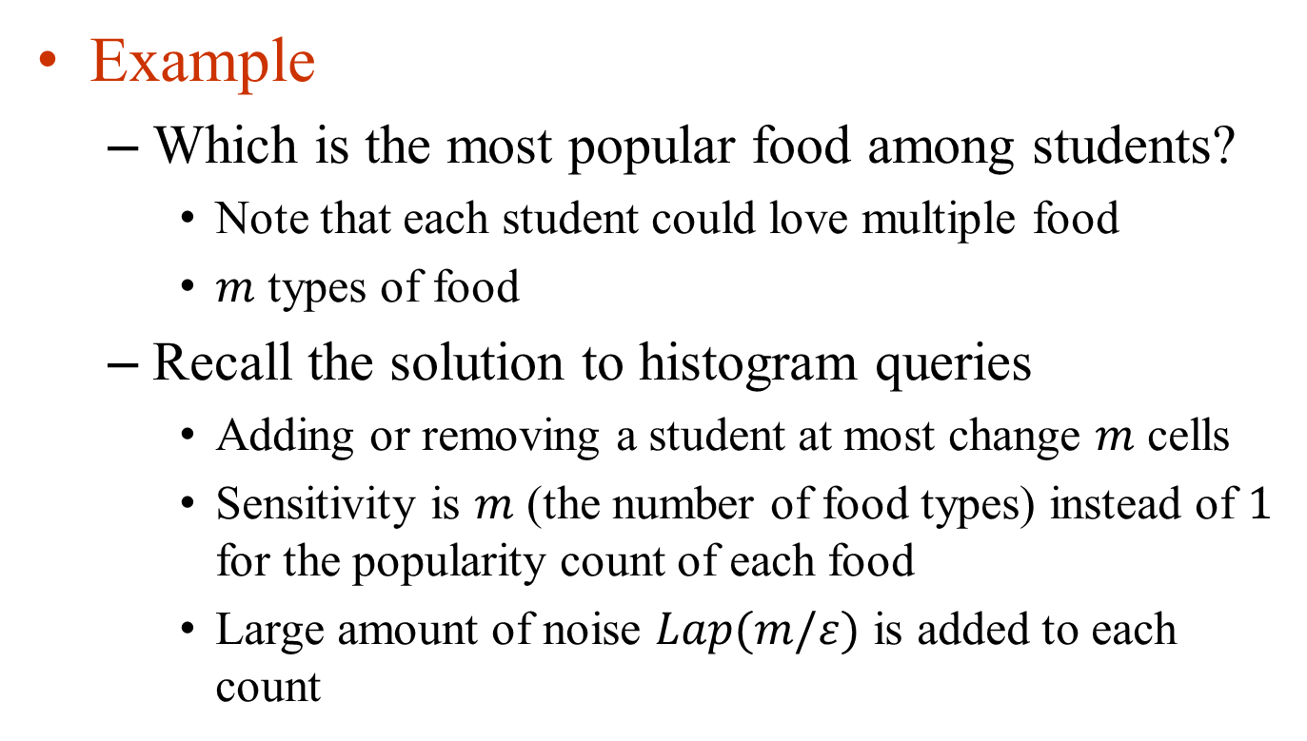
Laplace Mechanism
Example
Which is the most popular food among students?
Note that each student could love multiple food
$m$ types of food
Recall the solution to histogram queries
Adding or removing a student at most change $m$ cells
Sensitivity is $m$ (the number of food types) instead of $1$ for the popularity count of each food
Large amount of noise $Lap(m/ε)$ is added to each count

Slide 54
Differential Privacy for non-tabular data

Slide 55
Differential Privacy for Graphs
• Edge Differential Privacy
- Two graph differ in the presence or absence of an edge
• Node Differen'al Privacy
- Two graphs differ in the presence or absence of a vertex (and all its edges)

Slide 56
Queries on graphs and Sensitivity
• Number of edges in a graph
• Number of triangles in the graph
• Number of 2 length paths in the graph

Slide 57


Sensitivity under Edge Differential Privacy
• Number of edges in a graph
- Sensitivity = 1
• Number of triangles in the graph
- Sensitivity = m-2
(m is the number of nodes in the graph)
• Number of 2 length paths in the graph
- Sensitivity = m-2

Slide 58

Privacy of Laplace Mechanism
Consider any two neighboring databases D and D’
Consider some output O

Slide 59
Outline
Diﬀerential privacy
Algorithms
Deterministic algorithms
Randomized Response
Laplace mechanism
Exponential mechanism

Slide 60
Limitations of output perturbation
What if the answer is non-numeric?
“what is the most common nationality in this room”: Chinese/Indian/American…
Other examples?
What if the perturbed answer is not as good as the real answer?
“Which price would bring the most money from a set of buyers?”
Notes:
categorical instead of numeric

Slide 61


Example: Items for sale
$100
$100
If price is set at $100, make a revenue of $400
If price is set at $401, make a revenue of $401
$100
Best price: $401, Next best: $100
Revenue at $402 = $0
Revenue at $101 = $101
$401

Slide 62





[MT 07]
Exponential Mechanism
Consider some function f (can be deterministic or probabilistic):
Inputs Outputs
How to construct a differentially private version of f?
Module 2 Tutorial: Differential Privacy in the Wild 33

Slide 63
Exponential Mechanism
When F’s output is categorical instead of numeric, the Laplace mechanism does not apply, but the exponential mechanism can be used instead
The exponential mechanism releases a differentially private version of F, by sampling from F’s output domain Ω.

Slide 64
Exponential Mechanism
The sampling probability for each ω ∈ Ω is determined based on a user-specified score function u, which takes as input any dataset D and any element ω ∈ Ω, and outputs a numeric score u(D, ω) that measures the quality of ω:
A larger score indicates that ω is a better output with respect to D

Slide 65

Exponential Mechanism
Given a dataset D, the exponential mechanism samples ω ∈ Ω with a probability proportional to
$$e^{(\frac{u(D, ω)}{2Δ})}$$
The exponential mechanism achieves ε-differential privacy if $Δ≥ \frac{S(u)}{ε}$
Sensitivity of the Utility Score
$$S(u)≡\max_{\begin{aligned}r∈ℛ \\ D,D^{′}:{||D−D^{′}||}_{1}≤1\end{aligned}}{|u\left(D,r\right)−u(D^{′},r)|}$$

Slide 66

Exponential Mechanism
Example
$D$ consists of a number of $A$ and $B$, output the $A$ or $B$ with the larger count
Set
$u\left(D,A\right)=count\left(A\right)$
$u\left(D,B\right)=count\left(B\right)$
Sensitivity: $S(u)=1$
Adding or removing an A or a B will bring the utility function value a change at most 1
Which quality function is better?

Slide 67



Exponential Mechanism
$exp⁡(\frac{ε×u(D,r)}{2∆})$
$$Δ≥ \frac{S(u)}{ε}$$
Example
$D$ consists of a number of $A$ and $B$, output the $A$ or $B$ with the larger count. Let $u\left(D,A\right)=count\left(A\right)$ and $u\left(D,B\right)=count\left(B\right)$, so $∆u=1$
Given $D=(B, B)$, $count\left(A\right)=0$, $count\left(B\right)=2$
$\exp\left(\frac{ε×u\left(D,A\right)}{2S(u)}\right)=\exp\left(\frac{ε×0}{2×1}\right)=1$
$\exp\left(\frac{ε×u\left(D,B\right)}{2S(u)}\right)=\exp\left(\frac{ε×2}{2×1}\right)=e^{ε}$
$\operatorname{Pr}\left[ℳ_{E}\left(D,u,ℛ,ε\right)=A\right]=\frac{1}{1+e^{ε}}$
$\operatorname{Pr}\left[ℳ_{E}\left(D,u,ℛ,ε\right)=B\right]=\frac{e^{ε}}{1+e^{ε}}$

Slide 68
Recap: HISTOGRAM query
Suppose neighbors are D U {x}, D U {y}
How to release histogram query?
Sensitivity = 2
Add noise drawn from Lap(2/ε) to each count.

Slide 69

Why Composition?
Reasoning about privacy of a complex algorithm is hard.
Helps software design
– If building blocks are proven to be private, it would be easy to reason about privacy of a complex algorithm built entirely using these building blocks.

Slide 70


Composition theorems
Sequential composition
∑_{i}ε_{i} –differential privacy
Parallel composition max(ε_{i})–differential privacy

Slide 71
Sequential Composition
If M₁, M₂, ..., M_{k} are algorithms that access a private database D such that each M_{i} satisfies ε_{i} -differential privacy,
then the combination of their outputs satisfies ε-differential privacy with ε=ε₁+...+ε_{k}

Slide 72
Parallel Composition
If M₁, M₂, ..., M_{k} are algorithms that access disjoint databases D₁, D₂, …, D_{k} such that each M_{i} satisfies ε_{i} -differential privacy,
then the combination of their outputs satisfies ε-differential privacy with ε= max{ε₁,...,ε_{k}}

Slide 73
Postprocessing
If M₁ is an ε-differentially private algorithm that accesses a private database D,
then outputting M₂(M₁(D)) also satisfies ε- differential privacy.

Slide 74

Case Study: K-means Clustering

Slide 75





K-means Problem
Partition a set of points x₁, x₂, …, x_{n} into k clusters S₁, S₂, …, S_{k} such that the distance is minimized:
Mean of the cluster S_{i}

Slide 76

K-means Algorithm

Slide 77







Slide 78
Differentially Private K-means Algorithm
Privacy Goal: output:
the size of each cluster with differential privacy guarantee
Compute noisy sums of points in each cluster with differential privacy guarantee

Slide 79







Diﬀerentially Private K-means
Suppose we ﬁx the number of iterations to T (Each iteration uses a privacy budget of ε / T)
In each iteration (given a set of centers):
1. Noisily compute the size of each cluster
Sensitivity = 1
2. Compute noisy sums of points in each cluster
Sensitivity = size of domain = |dom|
3. Recompute new clusters based on 1. and 2.
Postprocessing (no impact on privacy)

Slide 80







Diﬀerentially Private Kmeans
Suppose we ﬁx the number of iterations to T (Each iteration uses a privacy budget of ε / T)
In each iteration (given a set of centers):
1. Noisily compute the size of each cluster
S(q) = 1
ε / 2T
2. Compute noisy sums of points in each clusterS(
clusterS(q) = |dom|
ε / 2T
3. Recompute new clusters based on 1. and 2.
S(q) = 0
0

Slide 81




Diﬀerentially Private Kmeans
Suppose we ﬁx the number of iterations to T (Each itera'on uses a privacy budget of ε / T)
In each iteration (given a set of centers):
1. Noisily compute the size of each cluster
Laplace(2T/ε)
2. Compute noisy sums of points in each cluster
Laplace(2T |dom| /ε)
3. Recompute new clusters based on 1. and 2.
Compute exactly

